Slide 1

HACKING CARROTS
HACKATHON
7-9 June 2019, Warsaw

Slide 2


Hey, we’re funDAO and we want to help you help responsibly

Slide 3
This is how much aid money was wasted just in South Africa in one year
3 957 460 800 $
according to the reports of Auditor General, Kimi Makwetu
https://www.gov.za/speeches/auditor-general-reports-overall-deterioration-audit-results-national-and-provincial
https://compareguru.co.za/news/money-south-african-government-wasted
Notes:
We are trying to solve the problem of aid distribution in LDC. Friction, corruption and low efficiency cause up to 70% loss of funds that were meant to reach the ones in need.
We are focusing on the Goal 4 - Ensure inclusive and equitable quality education. Our project is meant to reduce cost of international charity and embrace local communities when it comes to specify their needs.

Slide 5









How it works?
BENEFICIARY
PROVIDER
DONORS
IT’S A MATCH !
$
$
$
Flower Children Center in Arusha needs 50 chairs to equip the classroom
Esme, 37 years old, enterpreneur producing chairs in Tanzania
Donors, willing to help with small amounts of money

Slide 6

Take a look
DONORS
BENEFICIARIES

Slide 7






Making ends meet
FUNDS
PARTNERS

Slide 8

What else do we have?
funDAO’s
PINK PAPER
funDAO ICO smart contract
drafted smart contract, ICO-style, needs to be embedded within the app
prototyped iOS app for donors, still needed an app for beneficiaries
Notes:
1 - money donated to equip the classroom
2 - chairs delivered and confirmed by beneficiary
3 - money transferred to provider

Slide 9
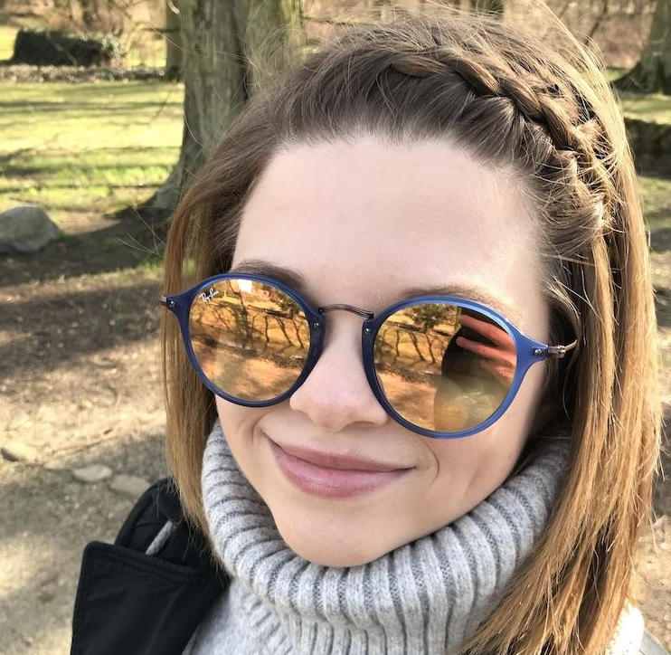
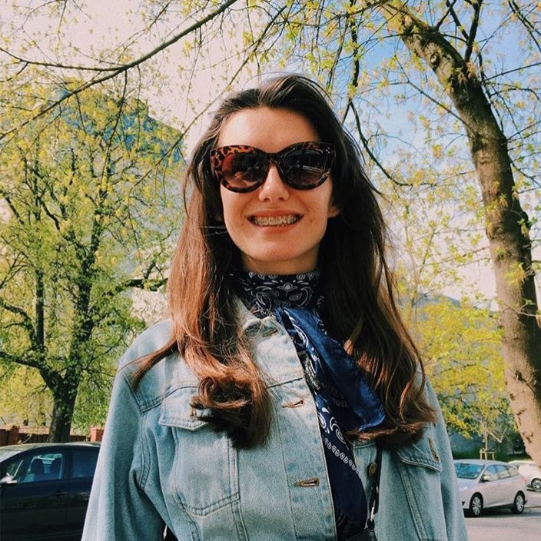
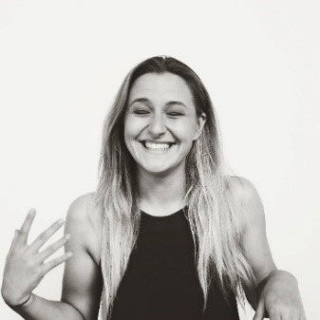
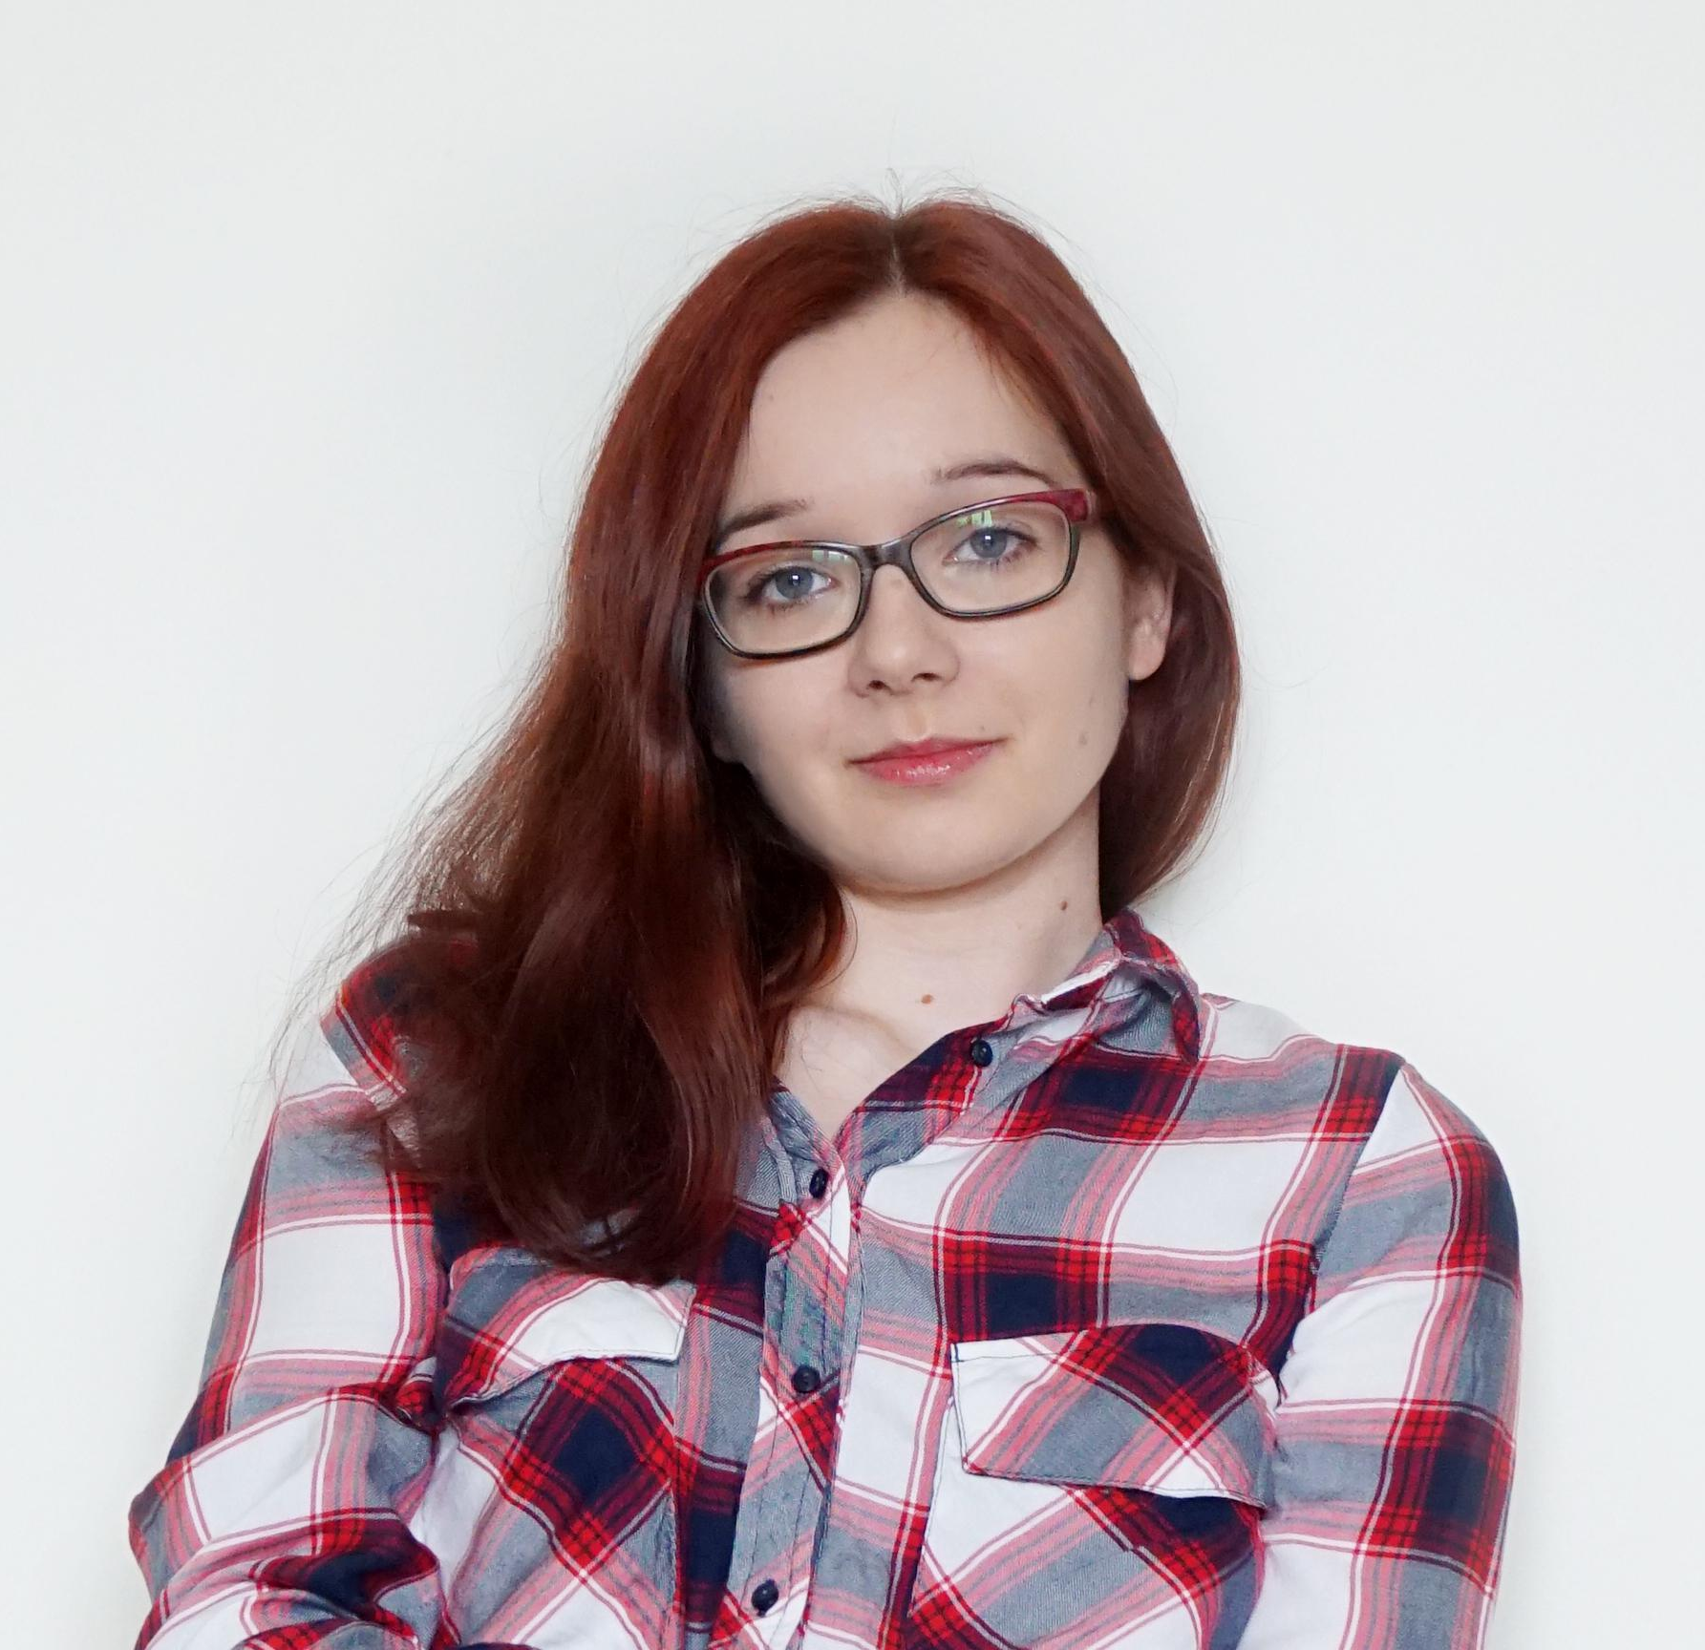
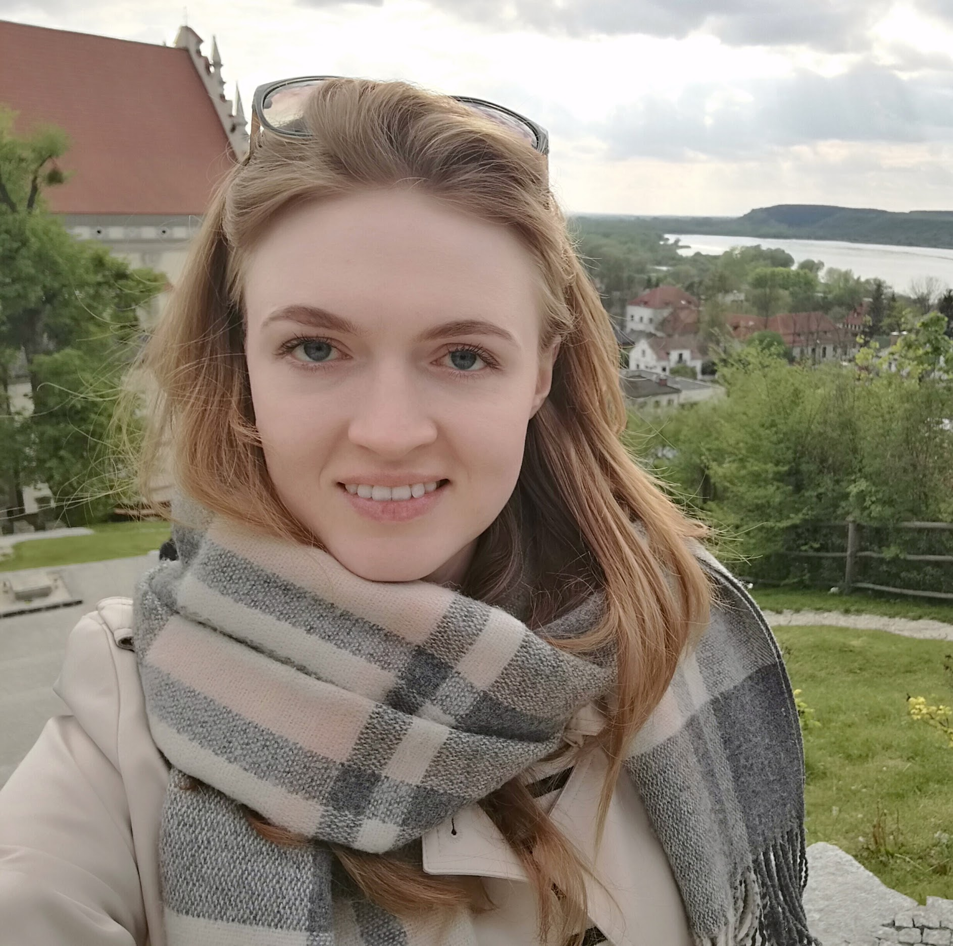
Who are we?
Agata
beginner at CX , UX enthusiast, working at Provident Polska SA, future student of business psychology, interested in yoga and mental health
Weronika
creative strategist for brand communication with NGO / humanitarian aid fundraising background & social activist at heart
Paulina
team captain
COO at Ramp Network
project manager by default, development economist by schooling
Monika
worked for NGOs in all shapes in forms i.a. Blockchain Hub Warsaw,
(soon-to-be) management graduate
Marta
tech analyst at Capco, ex-lawyer, AI enthusiast, working with the banks, helping them to become truly digital
Wiktor
.NET developer with taste for mobile development, working in Accenture for 2 years at banking project

Slide 10
UNDERLYING
MAGIC (or Probably Asked Question)
CRYPTO NO SAFE, CRYPTO NO STABLE
HOW WILL YOU EARN MONEY?
WHY ON BLOCKCHAIN?
You can track your money
We will be using DAI - a stablecoin pegged to $
% of transaction will be charged for maintenance, but we remain NON-profit
It’s cheaper than international transfers
Easy to collect transaction fee

Slide 11


THANK
YOU

